Slide 1
Sustainable Mobility Challenge
Does your organisation have an innovative solution for sustainable mobility?
Notes:
The global climate goals are set and the journey towards a sustainable future has begun.
Sweden is committed to push boundaries and be in the forefront of this development.
Let me introduce Sustainable Mobility Challenge – An international competition where Sweden invites the world’s most progressive people and organisations to take part in unlocking the potential of sustainable mobility services.

Slide 2
30%
Vision
A sustainable
energy system
of CO₂-emissions from domestic transport in Sweden
95%
A car is parked
of its lifetime
+50%
of all car travel, transport
1 person
Notes:
Sweden has a vision of a sustainable energy system.
Today traveling accounts for a substantial part of Sweden’s CO₂-emissions and Sweden is determined to reach a fossil independent transportation sector by 2045.
30% of Sweden’s CO₂-emissions come from domestic transports and cars account for a significant part.
Cars are parked 95% of their lifetime and more than 50% of all car travels transport just one single person.
To reach our vision Sweden needs to find new solutions and reach a broad implementation of sustainable mobility services.
The Swedish Energy Agency, together with Swedish Incubators and Science Parks (SISP), has therefore launched the international competition Sustainable Mobility Challenge.

Slide 3






The goal:
A seamless service that combines different transport alternatives and improves travel for people in everyday life - while reducing the need for a private car.
Illustratrationer: Adobe Stock
Notes:
We envision a future where we improve travel for people in everyday life while reducing the need of a private car.
We believe the key is in combining options from different transport providers into a single seamless mobile service, removing the hassle of planning and one-off payments.
The goal with the competition is therefore to find a seamless service that combines different transport alternatives and improves travel for people in everyday life - while reducing the need of a private car.

Slide 4
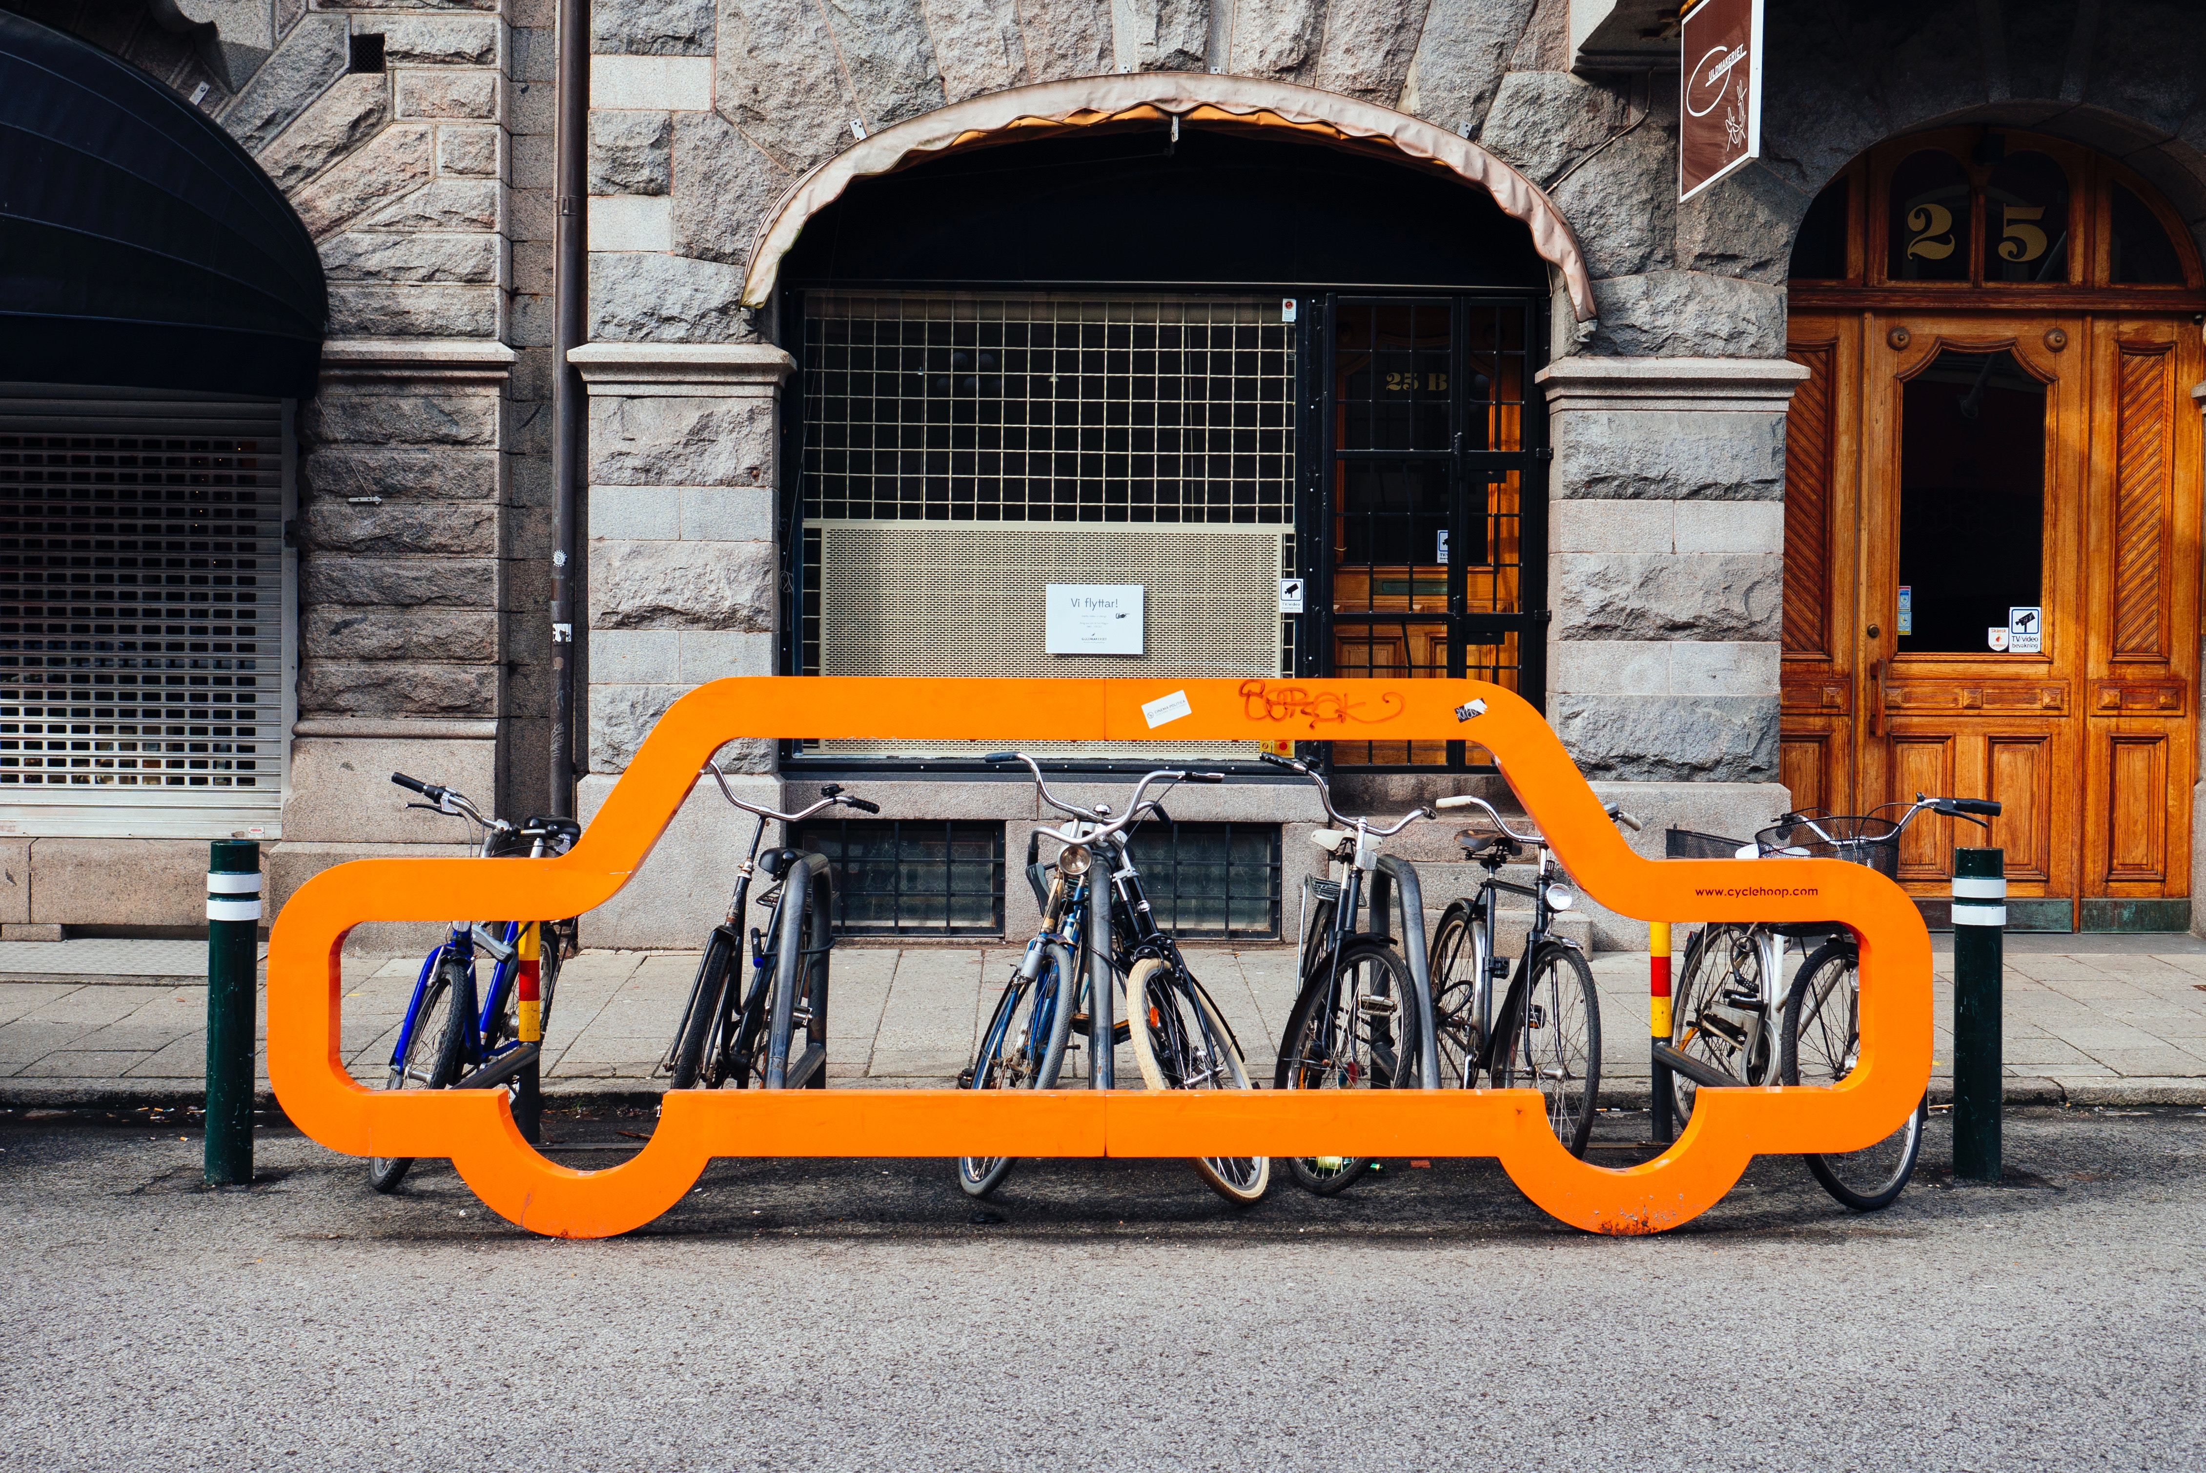
12.12.2017
We are looking for:
fossil-free, user-friendly personal transport services that meet the needs of today’s commuter and reduce the need for privately-owned vehicles
scalable solutions built on an open platform, enabling secure integration with other systems
Notes:
In this competition we are therefore looking for and will award fossil-free, user-friendly personal transport services that meet the needs of today’s commuter, and that reduce the need for privately-owned vehicles.
We invite applications from safe, reliable suppliers with a healthy business model and the ability to coordinate and provide sustainable transport alternatives within a region.
More specifically, proposed solutions should be built on an open platform; enable secure integration with other systems; and have opportunity for scale.
The initiative has created a network of proactive buyers with shared needs ready to test and invest in solutions meeting these needs.

Slide 5
Accelerated
Market introduction
Competition open
Implementation
(2018 - 2019 )
(2019 - 2020 )
(2020 -> )
Sustainable Mobility
Challenge
Register by Feb. 26
Apply by March 26
At least 5000 users involved in tests at selected sites for accelerated market introduction
Broad implementation of seamless and sustainable mobility services offering an attractive alternative to the privately-owned car.
Notes:
This is the timeline going forward.
The Sustainable Mobility Challenge opened on October 23, 2018 and will be open for registrations until February 26, 2019. Applications are open for an additional month until March 26, 2019 for those who have registered.
Three winners will be awarded with €50 000 each and offered support to accelerate marketintroduction at selected sites in Sweden.
After the test and verification period, focus will be on enabling a broad implementation of sustainable mobility services.

Slide 6
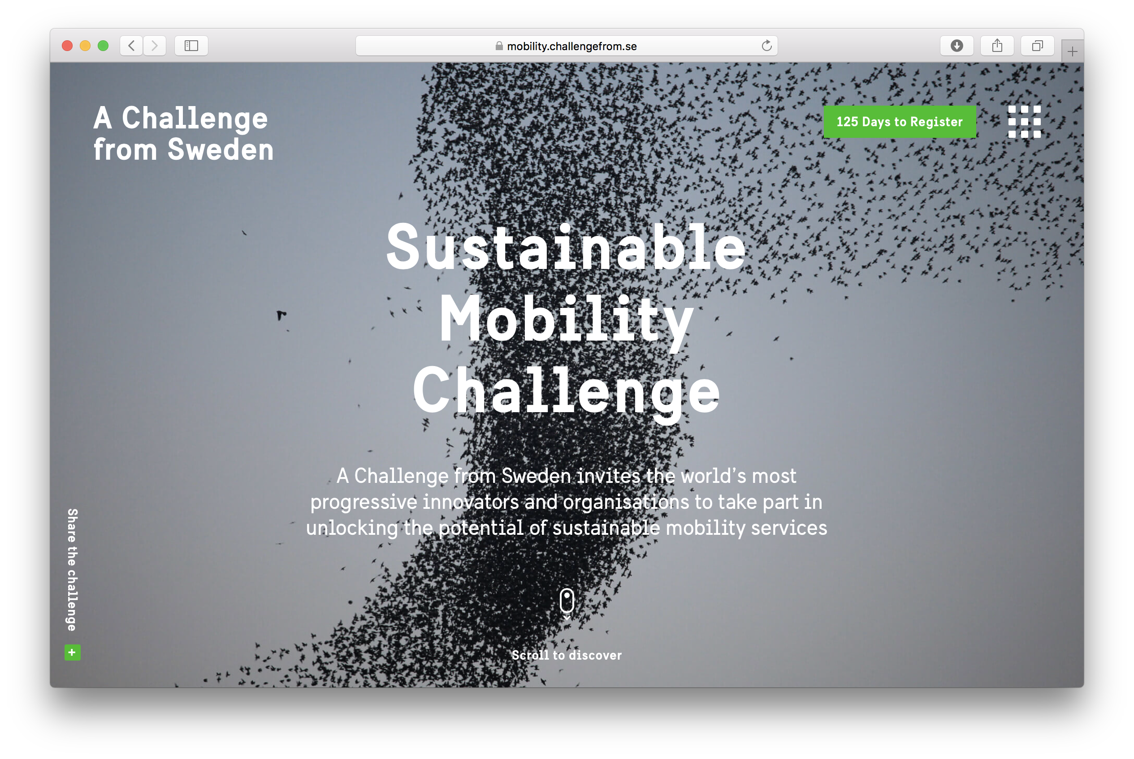
ZZ
mobility.challengefrom.se
Notes:
To apply and find more information about the competition, please visit mobility.challengefrom.se. Registrations are open until February 26, 2019, so please inform and recommend companies and actor whom may have a relevant solution for the Sustainable Mobility Challenge.

Slide 7
3
winners
Total award
€150000
+ Accelerated market-introduction in Sweden
Notes:
To summarize:
The Sustainable Mobility Challenge is looking for a seamless service that combines different transport alternatives and improves travel for people in everyday life - while reducing the need of a private car.
We will award fossil-free, user-friendly personal transport services that meet the needs of today’s commuter, built on an open platform; enabling secure integration with other systems; and have opportunity for scale.and that reduce the need for privately-owned vehicles.
A total award of €150 000 will be offered to three winners.
An additional €1.5 million is allocated for an open call grant to accelerate market introduction for 1-3 of the most transformational sustainable mobility solutions. (Other solutions than those in the competition may also apply for this grant).The winners of Sustainable Mobility Challenge will however have access to legal and financial expertise, as well as experts on the Swedish transport system, facilitating an entrance on the Swedish market.

Slide 8

Thank you!

